Slide 1
Pal-ette
Lara Gomez
Pantysh Ghurburrun
Basmala Moumneh
Zhe Cao
Connie Lin
Jeremy Cheng

Slide 2
Problems
01
02
03
04
05
Current Algorithms
Difficult to View Old Works
Share Art With Non-Website Users
Hard To Preserve Work
Weak Artist - Client Connection

Slide 3
Target Audience
13+ / 18+
Tech Savvy
Hobbyist + Professionals
Client
Artist 1
Art Clients
Artist 2

Slide 4
Proposed Solution
Navigation
Account Interaction
Posts
Art Preservation
Easily Scroll Through Site
Category Filtering
Gallery Creation
Follow And Favorite Pages
Notifications Of Posts
Ability To Credit Several Users
Specify Thumbnails -> Allowing For Easy Discovery
Reply Directly To Posts
Hall Of Fame Page To Be Appreciated
Ability To Download Art To Be Viewed As Intended

Slide 5
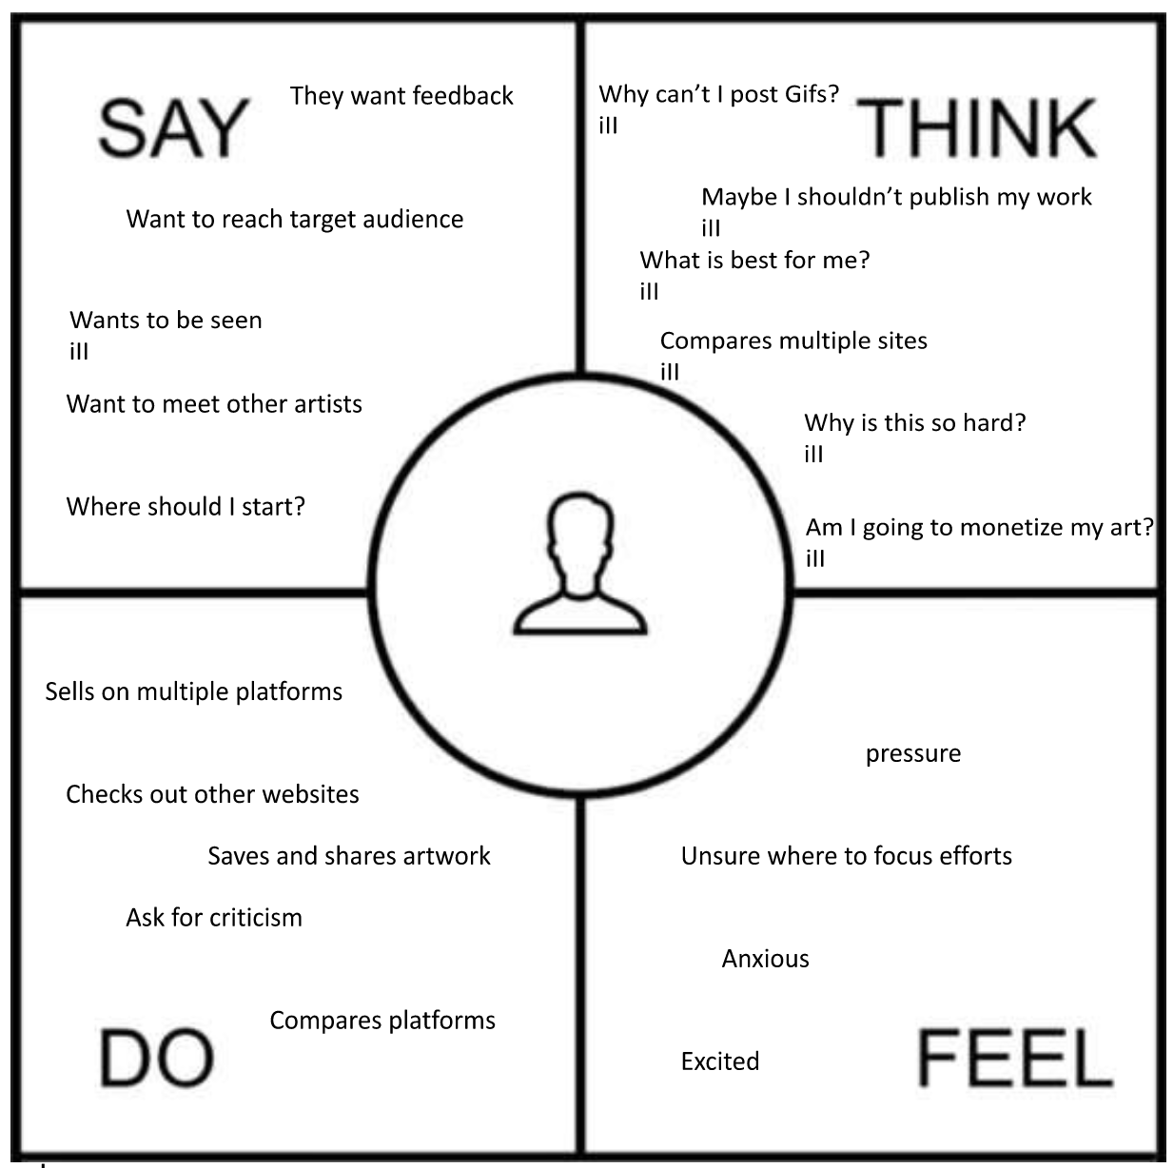
Gathering Requirements
Observation
Who: Hobbyists & Professionals
Where: DeviantArt, ArtStation, Instagram, Tumblr & Twitter
What:
Explore Different Forms & Genres Of Art
Get Feedback/Criticism or
Reach their target consumer.
Build Following & Credibility

Slide 6
Gathering Requirements
Interview
Main Questions
Subjective Feelings Through Open Questions & Further Questioning
Minimize Preconceived Notions
Semi-Structured Interviews
What social media do you use? What do you like and dislike about each?
Why do you post art?
Do you sell your art? If so, what is your process?
Who is your target audience?
What do you do to attract new viewers?

Slide 7
Results: Observation
portfolio
limits
algorithm
monetizing
discussion
Both artists and clients enjoy being able to organize art into portfolios or galleries.
Existing platforms limit the type of media and apply arbitrary constraints.
Algorithms make it difficult to find an audience.
Monetizing artwork is important for aspiring artists.
Artists enjoy having groups to discuss art and other subjects.

Slide 8
Results: Interviews - Platforms
?
?
All interviewed participants use Instagram.
Other sites used include:
LinkedIn
Twitter
Tumblr

Slide 9
Results: Interviews - Instagram
Likes
Dislikes
Used by a lot of people, broadening potential audience
Stories are good for networking and getting more views
Good for networking
Able to hide “likes”, allowing greater focus on interaction rather than numbers
Filters
Images have to be cropped in a specific way
Not easy to link to external stores
Algorithm seems to favour videos over images
Stories are not as good for small businesses

Slide 10
Results: Interviews - Other Platforms
Likes
Dislikes
Being able to share art in a way that links credit to the original poster
Different presentation and ratios
Ways to tag and organize posts
Being able to use as an overall professional portfolio
Negative engagement
Lack of audience / traction on some platforms

Slide 11
Interactive Prototype
Commissions
Galleries
Posting art
Purchase an artwork
Add image to a gallery
Post an image
We chose these tasks and features because they represent the wants people had for posting art, sharing art, and being able to receive support monetarily.
Also, due to being interaction-based, they can more easily be tested.

Slide 12
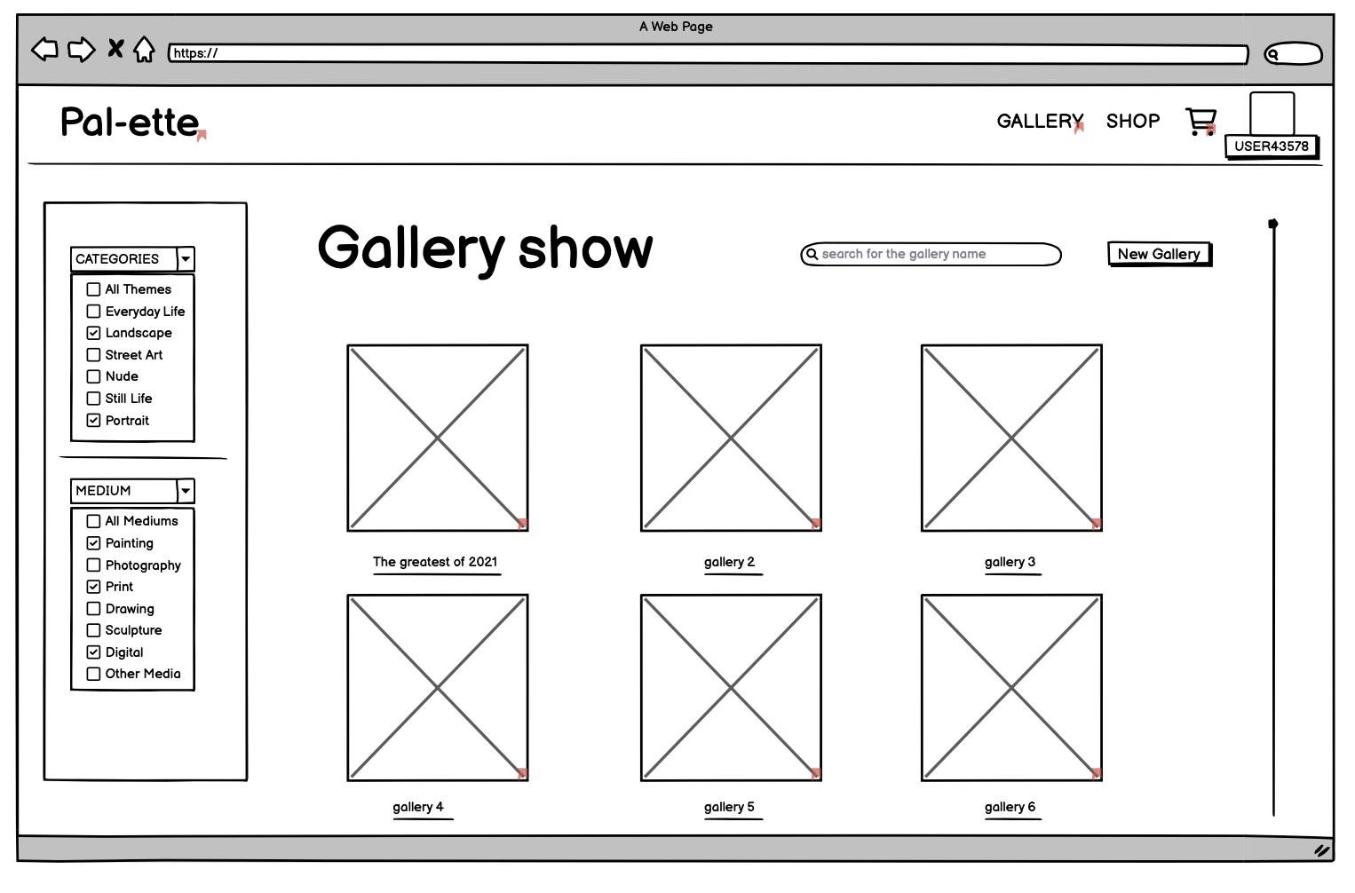
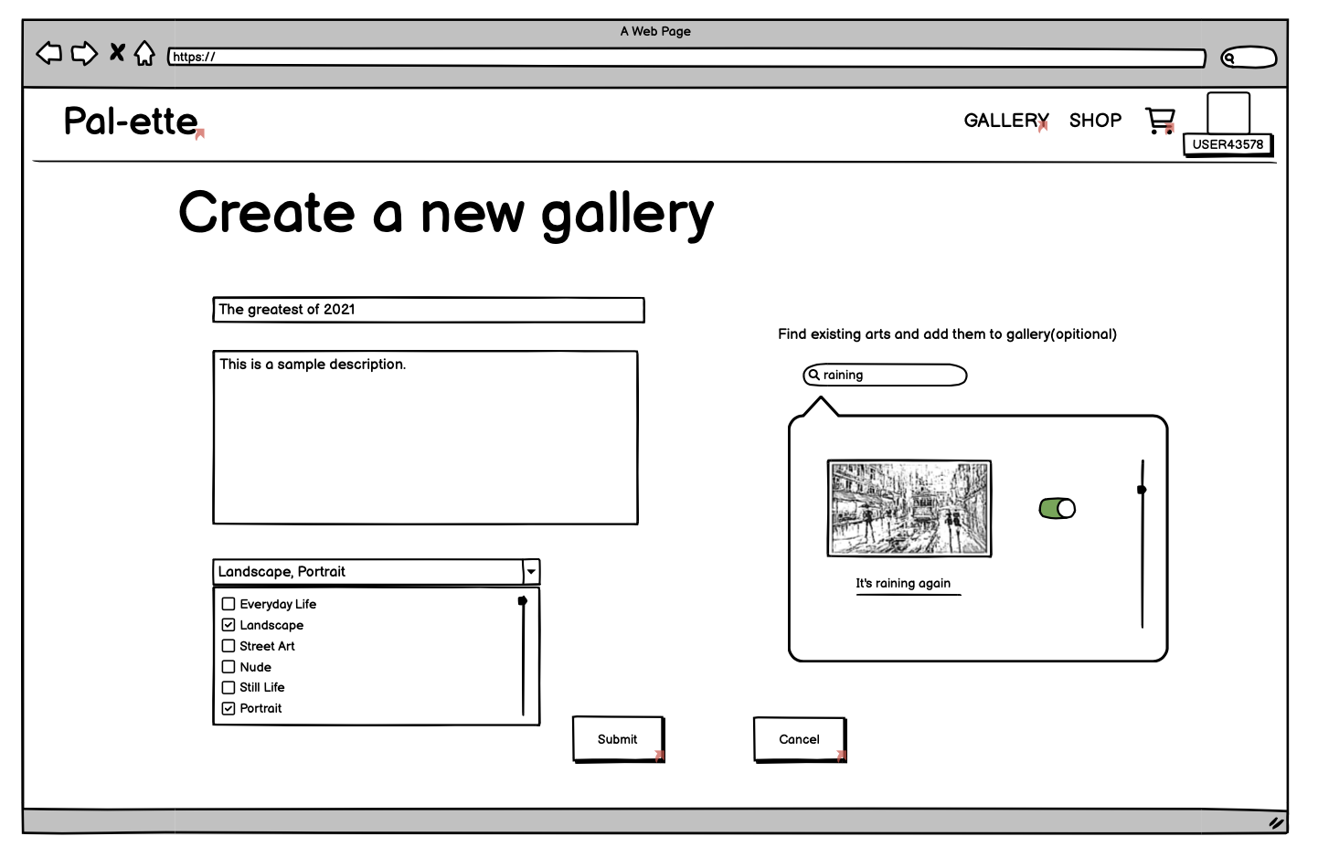

Slide 13
Evaluation Plan
User testing of interactive prototype conducted over Zoom with screen sharing
Five participants:
Mix of people previously interviewed and new participants
Included professional artists, art enjoyers, and people who sell art online
Some participants purchase art online, others don’t or do so infrequently
Interviews before and after testing the prototype
During test, users instructed to talk aloud about their thought process

Slide 14
Evaluation Plan: Structure
01
02
03
How often do you post art online?
How often do you purchase art online?
Testing
Did you find anything confusing?
Did you find the tasks easy or difficult to complete?
Anything surprising?
Did the feedback feel informative?
Was the word choice easy to understand?
Did you find the experience consistent with other websites?

Slide 15
Results: Quantitative
1/5 participants made errors
1/5 participants asked for help
All participants were able to successfully complete tasks
All users found the search bar confusing
Average Times for Tasks (Rounded down)
Posting: 1 min, 28 seconds
Make gallery: 1 min, 13 seconds
Purchase art: 1 min, 34 seconds

Slide 16
Results: Qualitative
Users made a lot of assumptions about how the site should work
Product was compared to ArtStation, a similar website
Users found some information to be communicated unclearly or found it overwhelming
Thought that doing things one at a time could get tedious, and wanted a more streamlined experience

Slide 17
The Future
Implement user suggestions
Provide easy access to user feedback such as a feedback window to let users know that the platform is encouraging them to give feedback.
Add tests more on the browsing side of things than strictly the posting side
These prototypes may have to be more than just wireframes due to the visual nature of art
Extra features that will attract more users to the platform
Offer personalization services, including pushing the categories of artwork that users want to see based on their browsing habits.

Slide 18
THANKS!
Do you have any questions?
Please keep this slide for attribution.

